Slide 1
MOVIE REVIEW SENTIMENT ANALYSIS
Dvij Joshi - 18075026
Navneet Taunk -18075041
Pulkit Srivastava - 18075045
Naveen Mall - 18075071
Under the guidance of
Dr. Bhaskar Biswas
Associate Professor
IIT(BHU) Varanasi

Slide 2
Data Preprocessing
STOP WORDS
Don’t add any meaning to text
Ex: ‘am’, ‘the’, ‘is’.
Used the NLTK to remove all the stop words.

Slide 3
Data Preprocessing
Stemming
Transforming of inflected word into its root form.
Ex: older -> old
Running -> run
Used Porter Stemmer class in NLTK

Slide 4
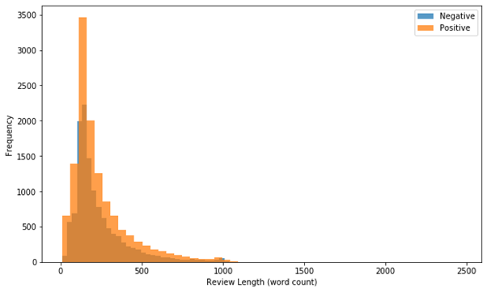
Distribution of the length of movie reviews (word count) split according to sentiment. The spread is similar in shape for both types of reviews however negative reviews are on average a tad shorter.

Slide 5
Feature Extraction - Bag of words
We obtain the vocabulary list from the corpus (whole text dataset). The length of the vocabulary list is equal to the length of the vector that will be output when we apply Bag of Words (BOW). For each item (could be an entry, sentence, line of text), we transform the text into a frequency count in the form of a vector.
We code this by setting up a count vectorizer from sklearn’s library, fit it on the training data and then transform both the training and test data.

Slide 6
NAIVE BAYES
CLASSIFICATION

Slide 7
Naive Bayes
Supervised Learning Model based probability and statistics.
Based on Bayes theorem.
P(H | x) = P(H) P(x | H) / P(x)

Slide 8
Naive Bayes
P(H | x) = P(H) P(x | H) / P(x)
P(H|x) is the posterior probability of hypothesis (H or target) given predictor (x or attribute).
P(H) is the prior probability of hypothesis
P(x|H) is the likelihood which is the probability of predictor given hypothesis.
P(x) is the prior probability of predictor.

Slide 9
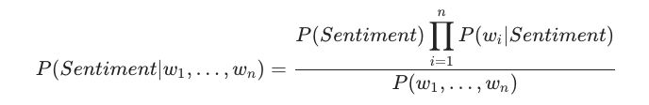
Naive Bayes
Used bag of words model.
Used sklearn.multinomialNB to train the data.
Obtained an accuracy of 0.85224 on the test dataset of 25000 entries.
Results were quite balanced for both the positive and the negative sentiments.

Slide 10
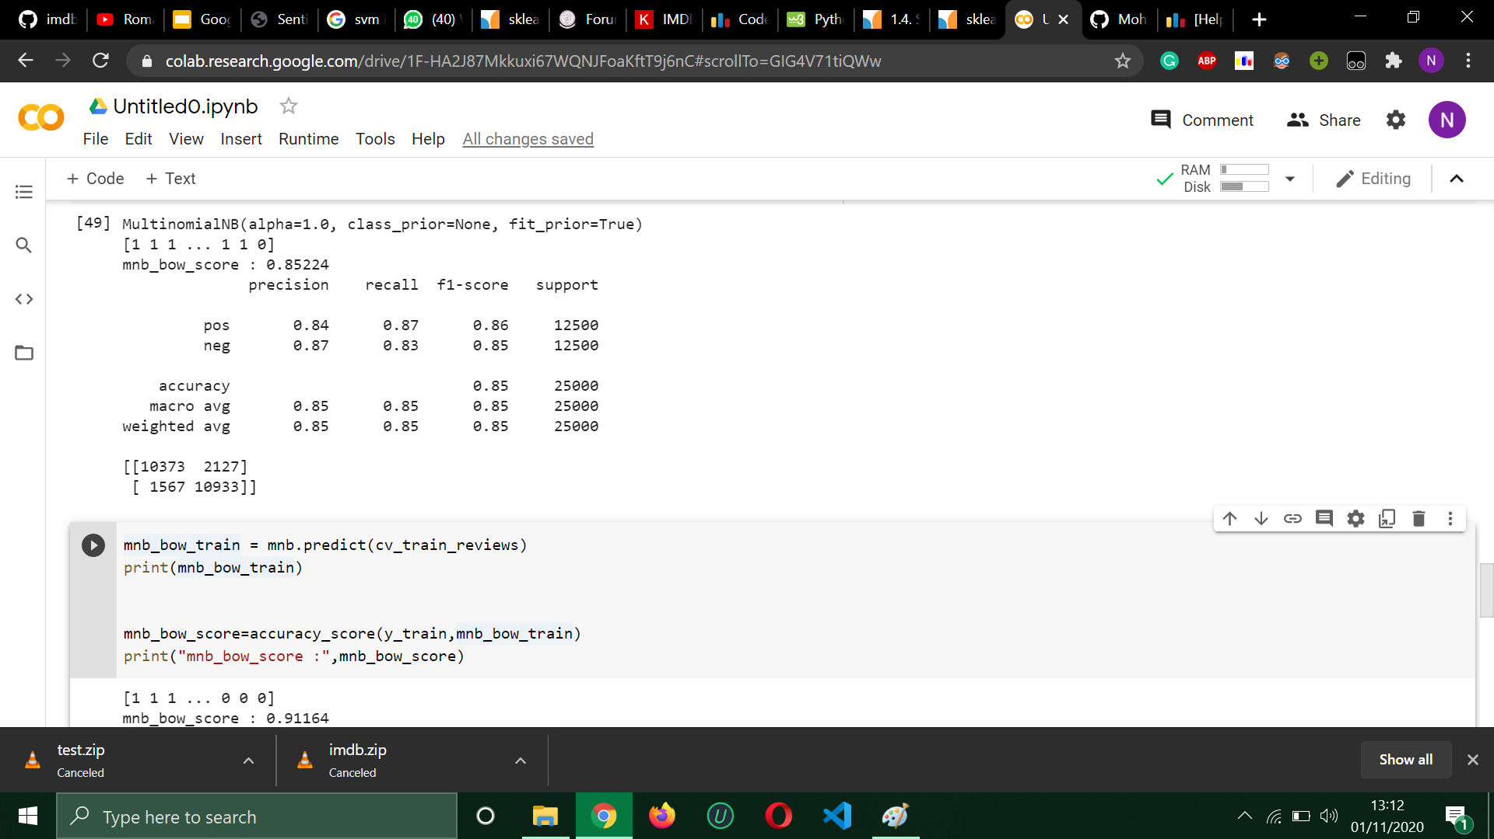
Naive Bayes

Slide 11
SUPPORT VECTOR MACHINE
(SVM)

Slide 12
Support Vector Machine
SVM is a supervised machine learning model.
Uses classification algorithms for binary classifications or multiclass classifications.
Constructs a hyperplane which separates the data points belonging to different classes.

Slide 13
Support Vector Machine
Hyperplane - A decision plane that separates a set of data points into different classes
Margin - The minimum euclidean distance between the hyperplane and the all set of data points.
Support Vectors - The data points which constitute the maximum margin.

Slide 14
Support Vector Machine
Maximizes the margin by solving the optimization problem.
For non-linear planes, SVM uses Kernel trick.
Used bag of words model as the training dataset.
Used sklearn.svm.SVC for the training.
Used linear kernel.

Slide 15
Support Vector Machine
Did binary classification using SVM.
Obtained an accuracy of 0.86172 on the test set of 25000 after training it on the 25000 training set.
The results were balanced for both the positive and negative sentiments.

Slide 16
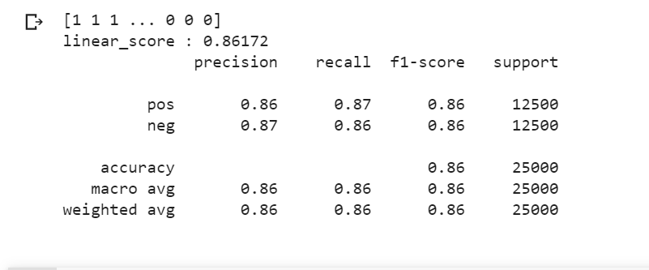
Support Vector Machine

Slide 17
LONG SHORT-TERM MEMORY
(LSTM)

Slide 18
LONG SHORT-TERM MEMORY (LSTM)
LSTM networks are an extension of recurrent neural networks (RNNs) mainly introduced to handle situations where RNNs fail.
LSTMs are explicitly to designed to solve the long-term dependency problem by remembering information for longer periods of time is their default behavior.
Keeping the training model unaltered, it is designed such that vanishing gradient problem is almost completely removed.

Slide 19
LONG SHORT-TERM MEMORY (LSTM)
LSTMs use three gates :
○ Input Gate
○ Output Gate
○ Forget Gate
With the help of these gates and Cell state LSTMs are able to preserve past information of sequential data.

Slide 20
LONG SHORT-TERM MEMORY (LSTM)
LSTMs use three gates :
○ Input Gate
○ Output Gate
○ Forget Gate
With the help of these gates and Cell state LSTMs are able to preserve past information of sequential data.

Slide 21
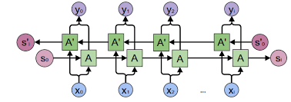
BIDIRECTIONAL LONG SHORT-TERM MEMORY (BI-LSTM)
Bi-LSTM couples two LSTM such that one LSTM is trained on sequence in direction of increasing index and the other is trained in the direction of decreasing index.
Using the hidden states of both LSTM, Bi-LSTM uses both past and future context to give the output.

Slide 22
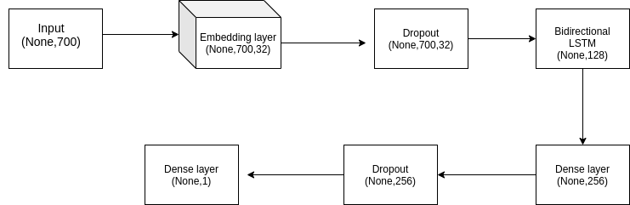
Model Architecture

Slide 23
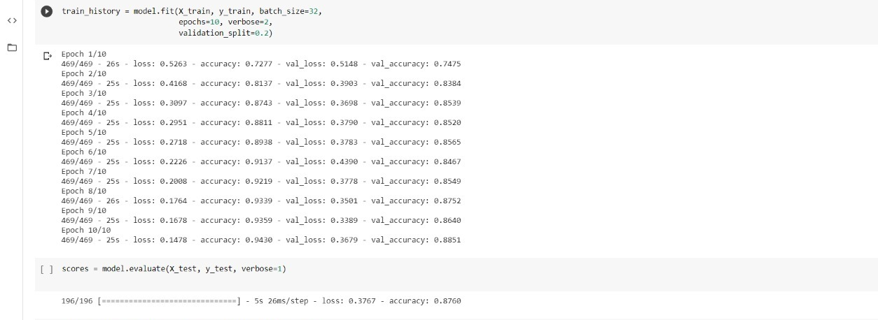
RESULTS

Slide 24
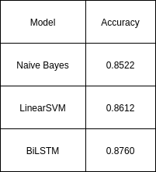
Model Comparison

Slide 25
Word Embeddings
Learned representation for text where words that have the same meaning have a similar representation.
Words are mapped to real-valued vectors, which are low-dimensional and dense. Number of features is much smaller than than size of vectors in one-hot encoding.
The representation is learned based on the context and usage of words. This allows words that are used in similar ways to result in having similar representations, naturally capturing their meaning

Slide 26
Pretrained Embeddings
Pre-trained Word Embeddings are the embeddings learned in one task that are used for solving another similar task. These embeddings are trained on large datasets, saved, and then used for solving other tasks. That’s why pre-trained word embeddings are a form of Transfer Learning.
Captures the syntax and semantic meaning of a word by training on a large corpora.
Increases efficiency of the model.
Several pre trained word-embeddings are present namely, Word2Vec, FastText, Glove.

Slide 27
Word Embedding Algorithms
1. word2vec
Word2Vec has been developed by Google and is trained on the Google News dataset (about 100 billion words)
Depending on the way the embeddings are learned, Word2Vec is classified into two approaches:
Continuous Bag-of-Words (CBOW)
Skip-gram model
CBOW Model - learns the embedding by predicting the current word based on its context.
SKIP-GRAM Model - learns by predicting the surrounding words given a current word.
Skip-Gram works well with small data and can represent rare words.
CBOW trains faster and works better for frequent words.

Slide 28
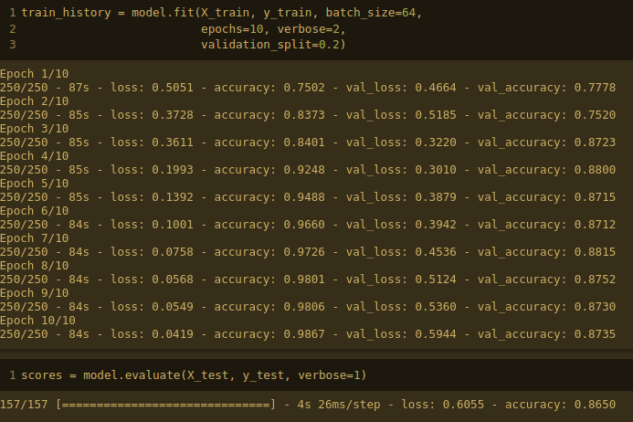
Result

Slide 29
Word Embedding Algorithms
2. FastText
Represents each word as n-gram of characters to allow the embeddings to understand its prefixes and suffixes.
Uses skip-gram model for learning embeddings.
Works well on rare words as the word in broken down in n-grams to get its embeddings.
It even works well on the words not present in the vocabulary.

Slide 30
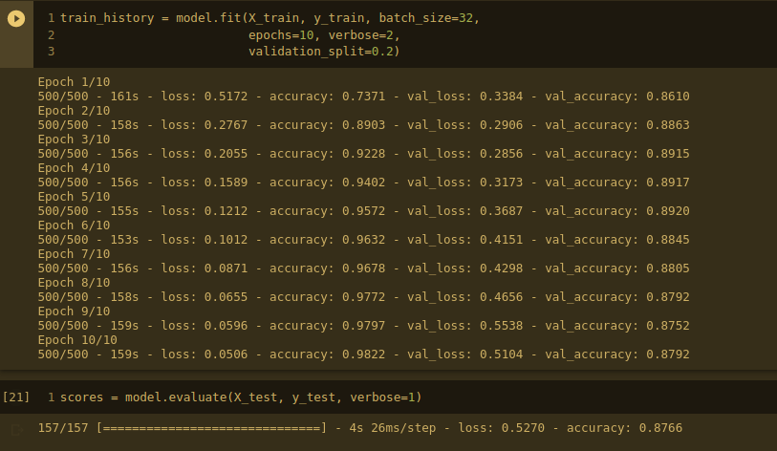
Result

Slide 31
Word Embedding Algorithms
3. GloVe
Global Vectors; GloVe is an unsupervised learning algorithm for obtaining vector representations for words. It uses word co-occurrence matrix to define local-context.
It performs better on word analogy and named entity recognition
The advantage of GloVe is that, unlike Word2vec, GloVe does not rely just on local statistics ( local context information of words), but incorporates global statistics (word co-occurrence) to obtain word vectors.

Slide 32
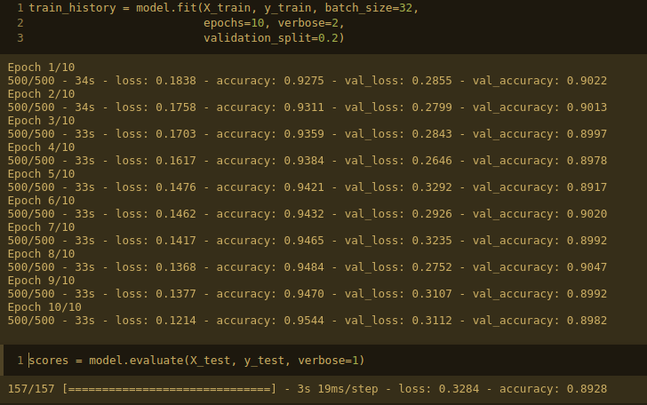
Result

Slide 33
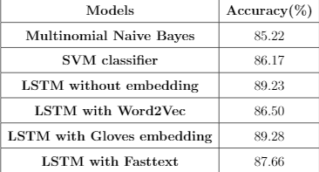
Models Used & Their Accuracies

Slide 34
CONCLUSION
As can be seen from the performance of various models, LSTM with Gloves embeddings achieved highest accuracy (89.28) and LSTM without word embeddings achieved a nearly similar accuracy (89.23).
SVM Classifier didn’t improve much in terms of accuracy as compared to Naive-Bayes model and took the longest time in training among all models.
Training time of LSTM with fastText embeddings was least among all the complex models and achieved a good accuracy.
All the complex models performed significantly better than Multinomial Naive-Bayes (85.22) which clearly explains the improvement in the performance with increasing complexity of algorithms.

